Slide 1
Hear Together
An Android application to assist the hearing impaired.
Team 48: Jessie Rutledge, Richard Smith, Andrew Peterson, John Ferguson, Paul Licata
Advisor/Client: Mat Wymore

Slide 2
Overview - Jessie
The project is an Android Studio application written in Java with an MVC project structure
The primary goal of the application is to assist the hearing impaired at low cost
The requirements to run the application at the most basic level include just an Android device, an earpiece, and a microphone (a pair of earbuds has both)
The application takes in a raw sound input from a microphone, and outputs a modified sound intended to tailor to an individual with some level of difficulty hearing, whether that be related to volume or some other quality related to the sound such as frequency or pitch
Includes Wi-Fi Direct connections for transferring sound data between two devices; also includes cloud functionality to save personal settings as well as conversations
Notes:
Java, MVC
Assist hearing impaired
Basic use: need android phone, mic, earbuds
Raw sound -> New sound, diff pitch, hearing
Optional: WiFi direct, Firebase

Slide 3
Problem Statement - Paul
Those with hearing impairments may struggle to feel included in group settings
Hearing aids are typically very expensive - ranging from one to four thousand dollars
Smartphones are commonplace now, almost everyone in the developed world owns one
Is it possible to extend these already owned consumer devices to allow for the enhancement of hearing to the hearing impaired?
Based on our research into available resources and current challenges, our team believes that yes, it is very possible.
Notes:
Hearing impaired individuals may sometimes struggle to be included in group conversations depending on the degree in which hearing is impaired, even if their hearing is still in a functional state.
The average cost of a single hearing aid can range between one to four thousand dollars. While for some this can be seen as a small price to pay for the freedom to hear more effectively, this can be the difference between making ends meat and suffering financial consequences.
Almost everybody in the developed, along with a growing number of people in the developing world owns a smartphone and some form of earpiece with an embedded microphone.
Is it possible to extend these already owned consumer devices to allow for the enhancement of hearing to the hearing impaired?
Based on our research into what is available and the current challenges, our team believes the answer to that question is that yes, it is in fact possible.

Slide 4
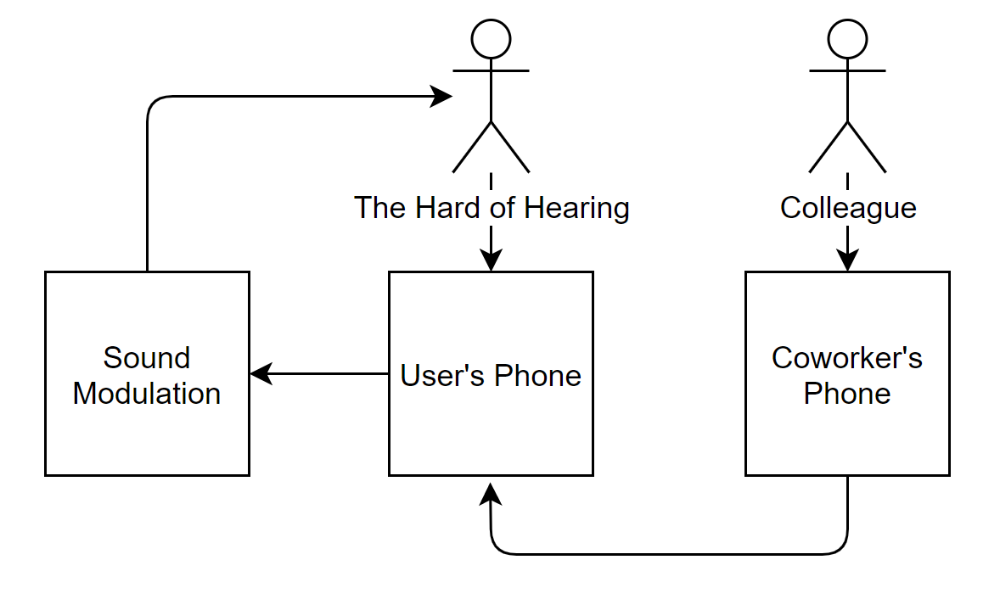
Conceptual Sketch - Jessie
The user initiates a “Session” or “Conversation” that can support themselves and another user connected to them
The user’s phone will transform and operate upon the data prior to sending a final sound output back to the user
A potential coworker (or some other form of conversational partner) will send their sound to the host for the host phone to perform FFT on
Notes:
User starts session
Session = conversation
User phone does FFT then modifies sound
Treat settings as a sort of bias to apply to data
Data converted back to sound
Third party converts to FFT before sending
Host phone does all the modification to sound

Slide 5
Functional Requirements - Paul
Must function on Android Devices
Users should be able to set-up rooms that others can connect to
Session must be secured so that only desired members can join
Users should be able to adjust the volume of other group members’ volume individually
Users should be able to manipulate incoming frequencies based on their own hearing needs
Notes:
First, since we are creating an Android app, our program must be able to run on Android Devices. This includes the emulator in Android studio and on physical phones and tablets. Next, users should be able to create and set-up a session which other users can connect to and join. Going off of that, only desired users designated by the host should be allowed to join the session. Users should be able to adjust the volume of specific users’ incoming audio. In addition to adjusting volume, a user should be able to manipulate incoming frequencies based on their own hearing needs. For example, a user who may not be able to hear lower frequencies well can boost the lower frequency range.

Slide 6
Constraints - Paul
Project will be completed by May 2020
The system operates on Android
The system uses compatible headphones
The code utilizes Java heavily
The connection between two or more phones can handle normal conversational distances
Notes:
The project is due in May, so it must be completed by then. We are making an Android application so it must run on physical Android devices. The system must be able to pick up sound from either compatible headphones or the microphone. We will use Java and various java libraries for virtually all of the components. Finally, the connection between two or more phones must be able to handle normal conversational distances. This means that we can expect that users will not be outside of the wifi direct limitations. A reasonable conversation will almost never exceed the wifi direct range.

Slide 7
Risks and Mitigations - Paul
Risks:
Mixed experience with Android studio across team members
None of our team has worked with sound processing before
Wifi Direct is being used which is less common and has fewer resources compared to Bluetooth
Mitigations
We used spikes to quickly research and learn new topics
We prototyped and experimented by using physical the Android emulator as well as physical devices
Utilizing prebuilt libraries when possible
Notes:
Most of our risks are related to the lack of knowledge of some of the topics related to the application. For example, nobody on our team was familiar with sound processing before we started the project. Next, some of us had varying experience with android studio, but nobody is an expert by any means. Connecting multiple phones together is also a subject that we initially did not know a lot about. Especially since we are using WiFi direct to connect phones rather than Bluetooth which is more common. However, we have plans in place to counteract this. We are using spikes to quickly research and learn about the new topics. We are prototyping and experimenting a lot to lower the chances of encountering a bug later on. Finally, we are using prebuilt libraries whenever possible to avoid certain risks completely.

Slide 8
Resources and Cost Estimate - John
Resources needed include PCs with capability of running and compiling Java through Android Studio and Android devices
Individuals working on Wi-Fi connectivity require two android devices
No monetary cost to the team, unowned devices provided by campus
Team includes members who already own a number of android devices

Slide 9
Weekly Schedule - Andrew
Consistent weekly meetings with our client to discuss progress and difficulties experienced the previous week.
Weekly coding sessions where the group would assemble to work together on code within the same room.
The normal schedule would also include time to complete the biweekly reports every other week.
Notes:
We followed an agile methodology towards scheduling. That is, instead of declaring deadlines early on in the project, we worked flexibly to understand our clients needs. As such, we had a meeting every week with our client to discuss our progress and setbacks.
To ensure we were making some progress every week, we instituted a weekly coding session every sunday. Before COVID, we would all go to a lab room on campus to work. After COVID, we would all get in a group call to work on our project.
Our schedule included time to complete biweekly reports every other week, on our own.

Slide 10
Project Milestones - Andrew
Original Milestones
Group Connection - The application is able to support up to 8 simultaneous connections transferring data at once
Sound Modification - The application is able to apply a user defined settings as a bias on the output of the data
Adjusted Milestones (in consultation with the client)
Single connection - The application is able to support a single connection between two devices transferring data
Sound modification - The application has a proven proof of concept ability to modify sound within the frequency domain as a result of some sort of user defined setting
Notes:
Before COVID, we had two major milestones. The first was to have an application that could support up to 8 simultaneous connections. The second was to be able to apply user defined settings to modify the sound as each individual user saw fit.
After COVID, we had to make some adjustments.

Slide 11
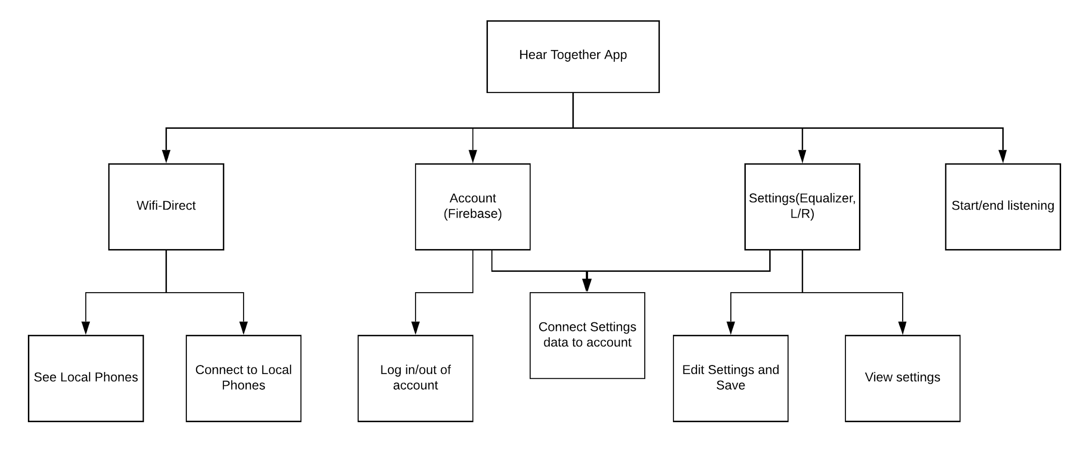
Functional Decomposition - Andrew
Notes:
Andrew - On this slide, you can see the functional decomposition of our app. Our application is broken into four main sets of functionalities. First we have the functionalities related to Wifi-Direct. Each phone should be able to both view other phones which are open to connections, and to initiate the connection process. This will create a session, which can then also be seen by other phones with the application installed. Secondly, we have the account related functionality. Each user should be able to log in and out of their account, as well as connect their settings to their account, to save them in the cloud. The third set of functionalities is about the settings. Each phone should be able to set their apps settings, which include being able to change the volume for specified ranges of frequencies, as well as the left/right balance. These settings should be set in profiles, so the user can maintain different profiles for different situations. They should also be able to see their current settings. Finally, the last set of functionalities relates to starting and stopping the listening process.

Slide 12
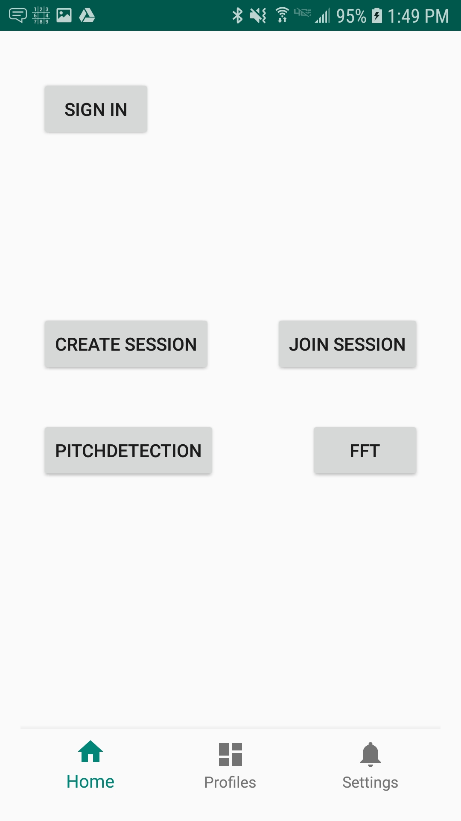
Design - Andrew
Android application coded in Java for functionality and uses XML to create UI layout
Firebase
Uses MVC architecture to support higher modularity of code and overall maintainability of the app
User interface includes three main pages; Home, Profiles, and Settings
Notes:
All design and code is completely implemented in Android Studio, using Java; an object oriented language that pairs well with the Android Studio IDE. Also we paired Java with XML for implementation of the apps overall UI,

Slide 13
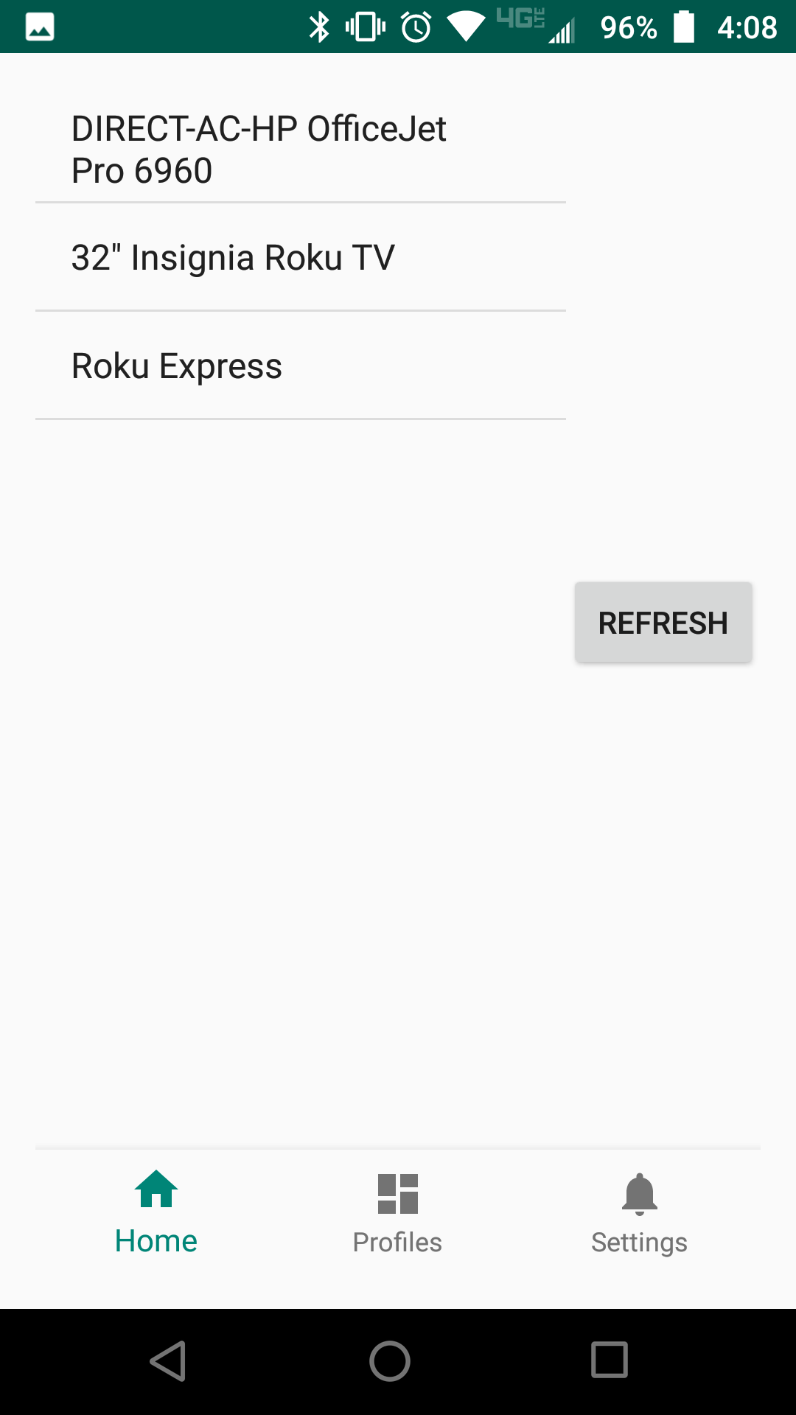
Networking Design - John
Technology used is WiFi Direct
Significant portion of the project makeup
Threading for clients and server, also threading for sending and receiving info
Host of session is defined as the server, all clients connect to that
Session is treated as a medium to initiate communication, all actual communication done within previously mentioned threads
“Message” object is used as a model containing contents to send to another user, allows for potential of sending other types of data
Notes:
All design and code is completely implemented in Android Studio, using Java; an object oriented language that pairs well with the Android Studio IDE. Also we paired Java with XML for implementation of the apps overall UI,

Slide 14
Test Plan - Jessie
Frequent switching of technologies, found automated testing too much of a challenge for both the switching of dependencies and difficult to use with the dependencies themselves to begin with
Reliance on manual testing, log statements
Debugging with Android Studio emulator and hardware by finding bugs with predetermined use cases of the app
Test all code before pushing to master branch
Latency and delay testing for both communication and overall sound
Manual testing of WiFi connectivity
Notes:
We’re also all familiar with the android built in debugger which will help us out a lot with fixing any broken code or finding where the broken code is in general. Log statements while running the emulator in android studio will also be used heavily. Log statements are very helpful for finding out if the connection to the firebase is successful or to check if any specific functions run correctly in the app. It’s mandatory to have your own branch for whatever feature you’re working on so that after testing your specific feature, it can merge into master and keep master with a clean commit history. For testing sound transformation we will store recorded testings as mp3 in firebase, and then check on the mp3 files output to see if it came out to be correct or not.

Slide 15
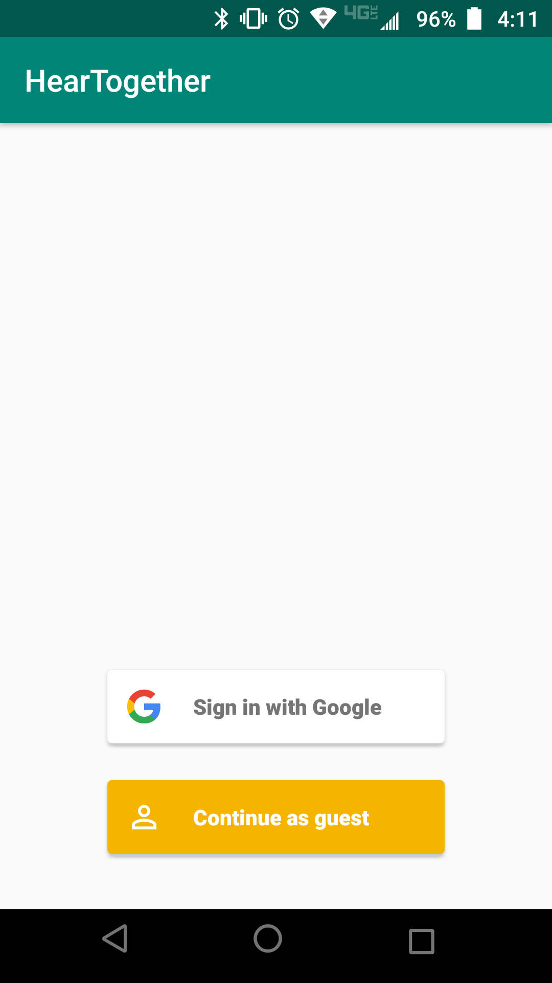
Prototype Implementation - John
Completed
Can establish a connection via WiFi Direct
Can use Firebase Server and access login service
Can use Equalizer to capture and replay sound with modifications
In Progress
WiFi Direct and Equalizer working together
Notes:
Three distinct prototypes
One that is able to detect and display wifi direct enabled devices
One that is able to connect to a firebase server and accept connecting with other accounts
One that can register sound via a devices microphone and use Tarsos to analyze the sound

Slide 16
Platforms and Technology - Richard
What worked
Android Studio
Firebase
Wifi Direct (second implementation)
JTransforms
Android Equalizer class
What didn’t work
Bluetooth (defunct, removed)
WiFi Direct (first implementation)
TarsosDSP (defunct, removed)
Notes:
-Implemented Entirely in the Android Studio IDE for use with any android device that runs Android version 7 and up
-Firebase was used for our database and sign in authentication method
- Had Bluetooth initially but moved over to wifi due to lower latency and higher upper bandwidth limit
-Old Wifi Direct was too difficult to send messages on so we made a second implementation that abstracts the payload over the connection, allowing for better levels of fault tolerance when refactoring sound
- TarsosDSP used initially but was too high-level to use effectively. Needed less abstraction so we switched to JTransforms
-Jtranforms is a open source multithreaded FFT library written purely in java which helped manipulate the sound data and improve performance in the app
-Android default Equalizer class provided us with an interface to control audio effects

Slide 17
Engineering Standards and Design Practices - Richard
Engineering Standards
IEEE 1448a-1996 - Software Life Cycle Processes
IEEE 1233-1996 - IEEE Guide for Developing System Requirements Specifications
Design Practices
DRY Principle
Defensive Coding
Regular Refactoring
Version Control Systems
Notes:
Software life cycle processes - established a common framework, with well-defined terminology, that we referenced throughout our project
IEEE guide for Dev- was a guide for setting up our projects requirements and conditions for incorporating operational concepts, design constraints, and design configuration requirements into our specification. Such as using the IEEE 802.11 wifi requirement
DRY- Don't repeat yourself is a principle of software development aimed at reducing repetition of software patterns by replacing it with abstractions or using data normalization to avoid redundancy.
Defensive Coding- included making code more reader friendly and helped reduce the overall number of bugs and issues during development
Regular Refactoring- every week we would refactor old code to clean it up and make it more concise, which improves the readability of the code.
Version Control Systems- We use GIT with gitlab and push/pull all code from separate feature branches during development, when we wanted to merge a separate feature branch with master, we would make a merge request for the entire team to read and go over the code before allowing the merge, which helps ensure the master branch consists of only clean and error free code

Slide 18
Task responsibility/contributions of each project member - Group
Jessie
Assisted with implementation of WiFi Direct
Fragment design and switching; interconnectivity of components
Andrew
Integration with Firebase Auth UI
Equalizer and sound transformation algorithm design
Paul
Sound manipulation with Jtransforms
Utilizing the Android Equalizer for change sound
John
Testing on Systems’
Assisted with implementation of WiFi Direct
Gabe
Integration with Firebase Firestore
Real time database implementation for overall storage of app data

Slide 19
Future prospects - Jessie
Integration of different project parts more effectively
WiFi Direct redesign expansion
Determining better ways to transform sound
Efficiency
Algorithms that use less data to transform sound, “Sparse” fft
Fidelity
Algorithms that separate noise from signal more effectively
Redesign of equalizer to not be dependent on hardware implementation
Reach original milestones

Slide 20
Conclusion

